Slide 1
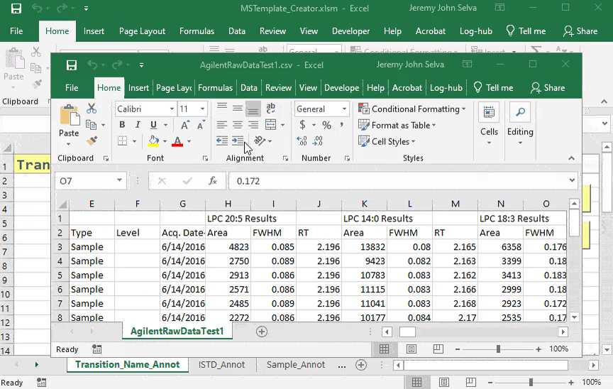
Load Transition Name from Raw Data

Slide 2
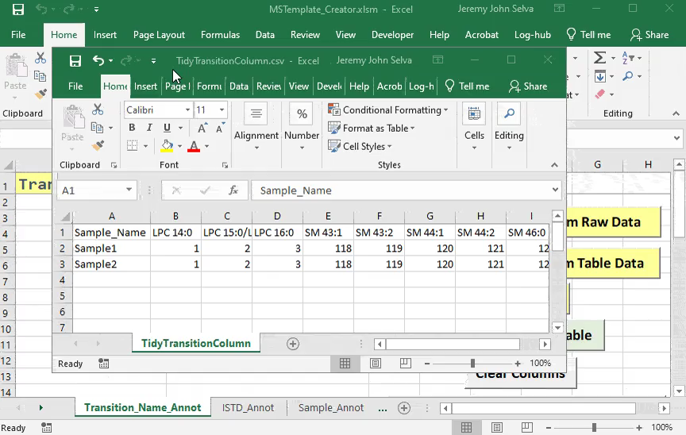
Load Transition Name from Table Data

Slide 3
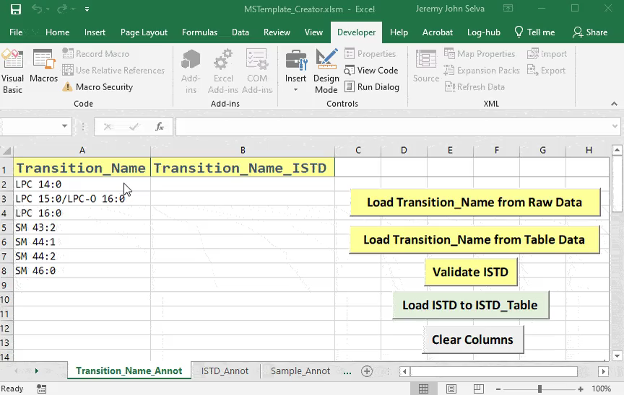
Validate ISTD

Slide 4
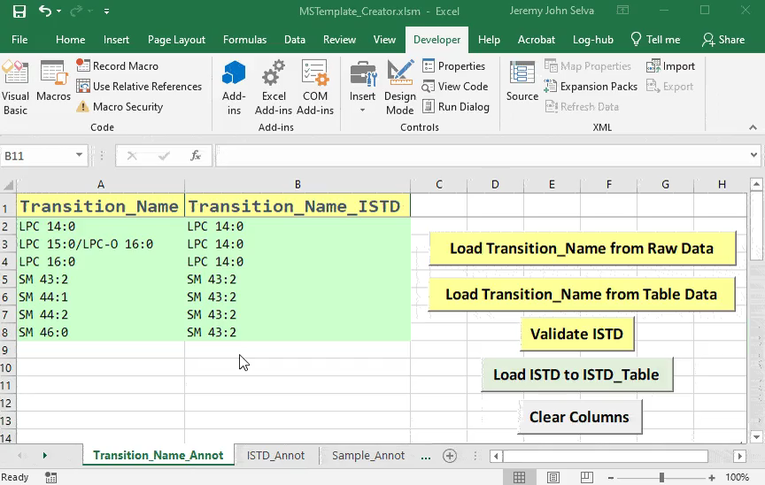
Load ISTD to ISTD Table

Slide 5
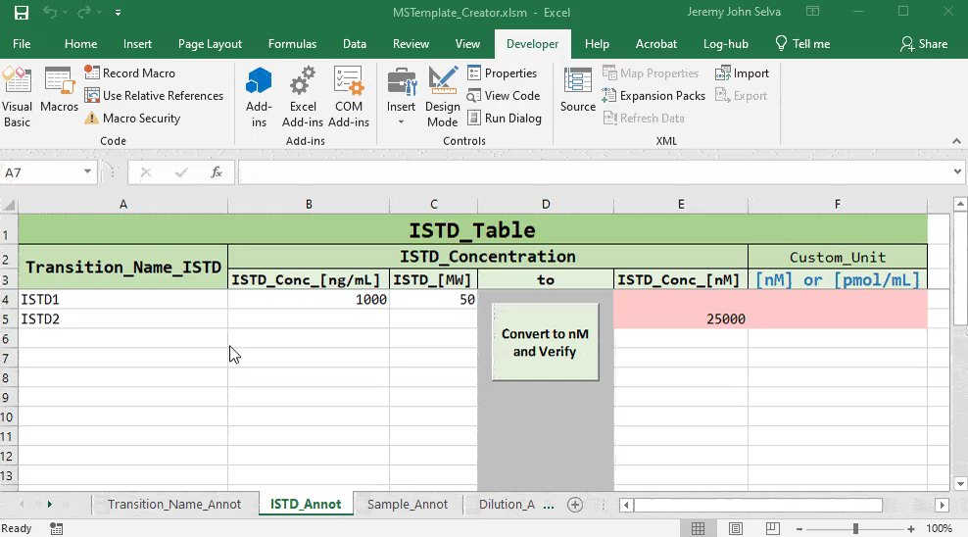
Convert to nM

Slide 6
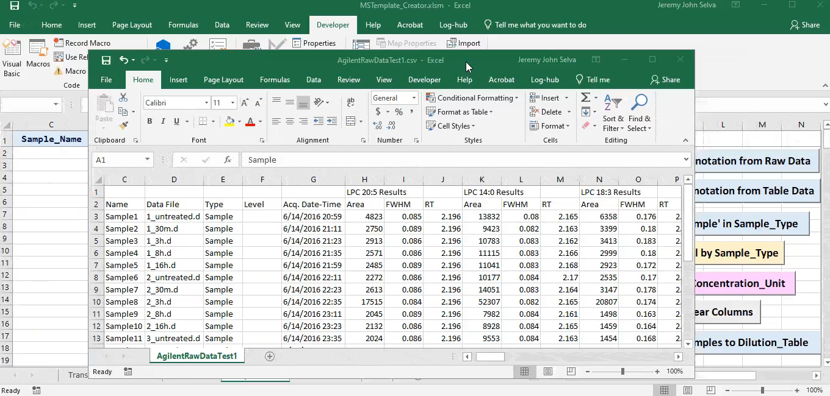
Load Sample Annotation from Raw Data

Slide 7
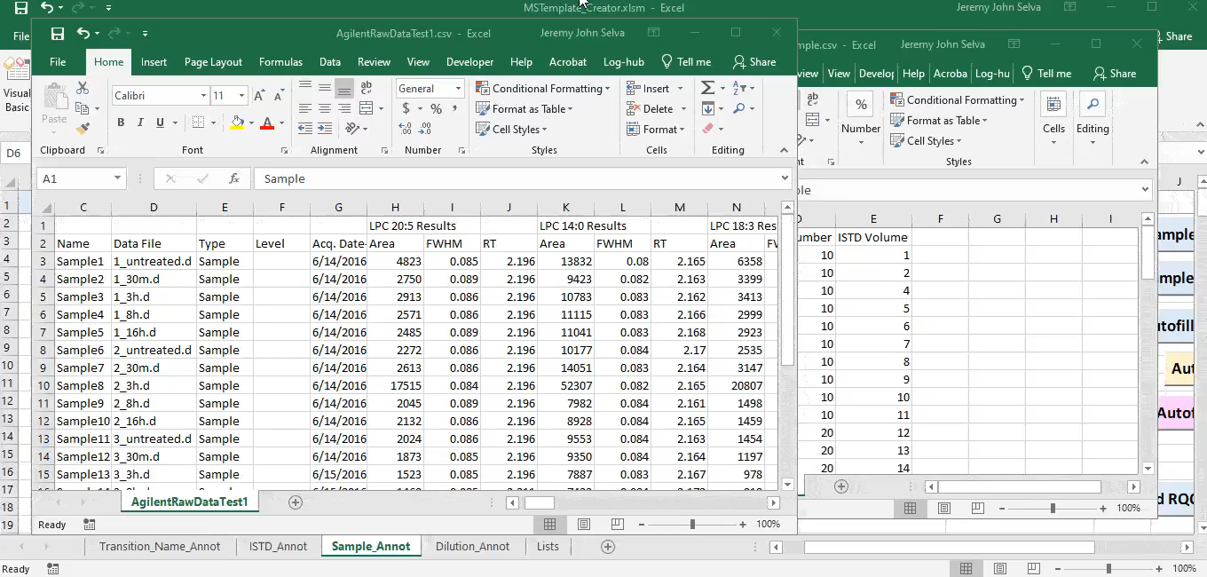
Merge Raw Data with Sample Annotation

Slide 8
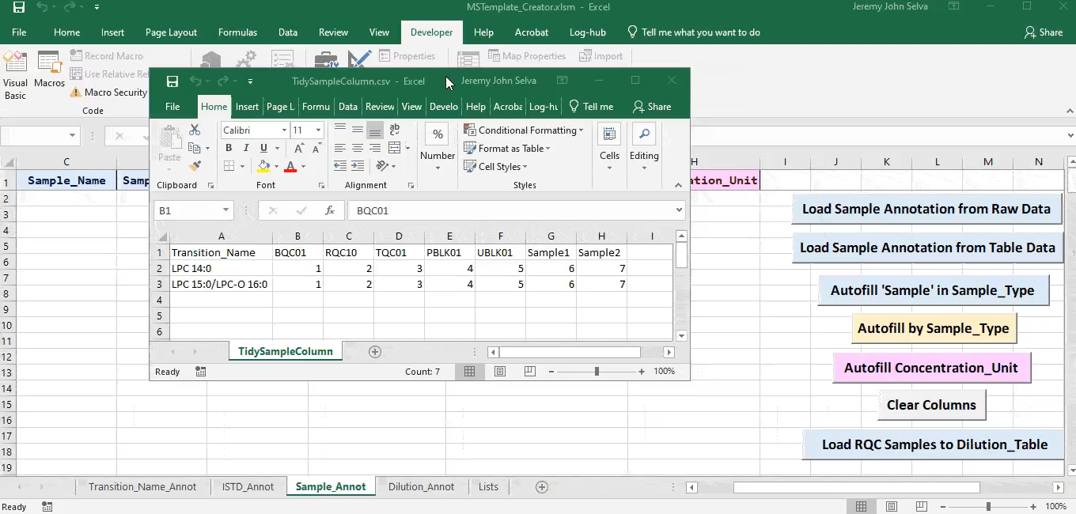
Load Sample Annotation from Table Data

Slide 9
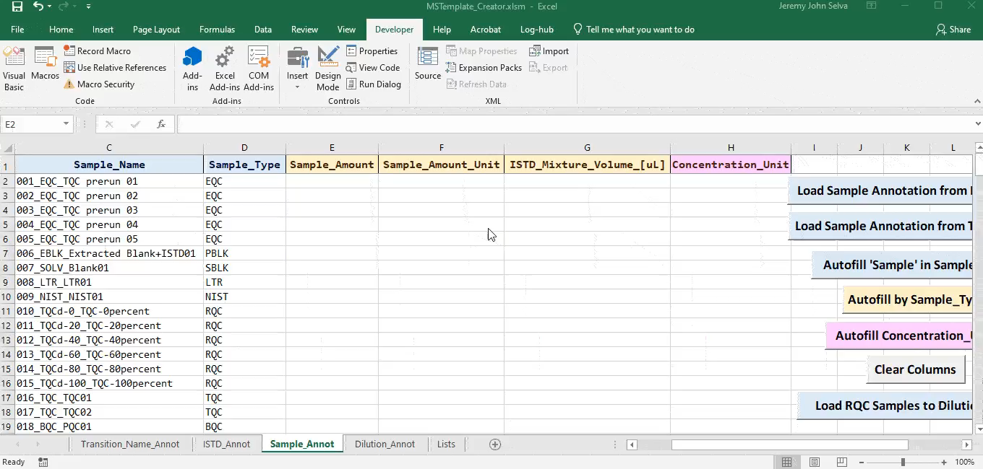
Autofill by Sample Type

Slide 10
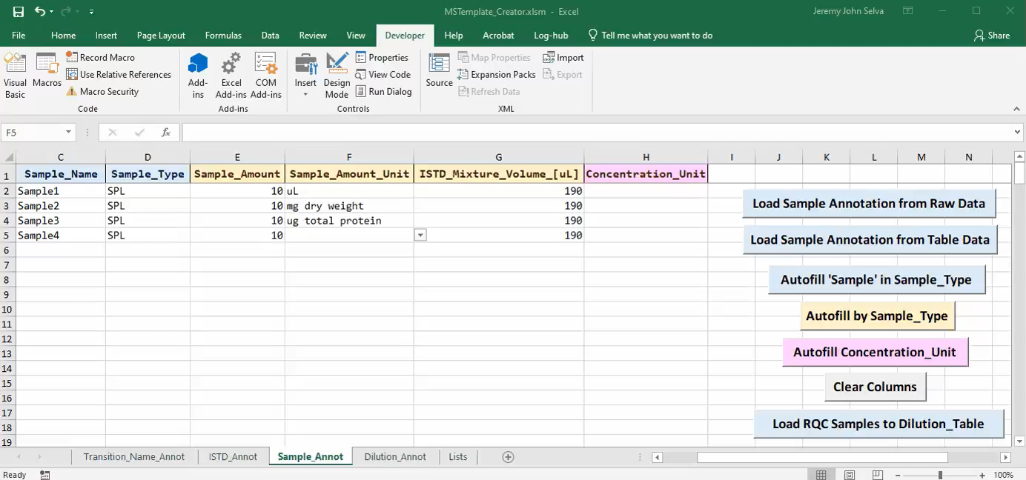
Autofill Concentration Unit

Slide 11
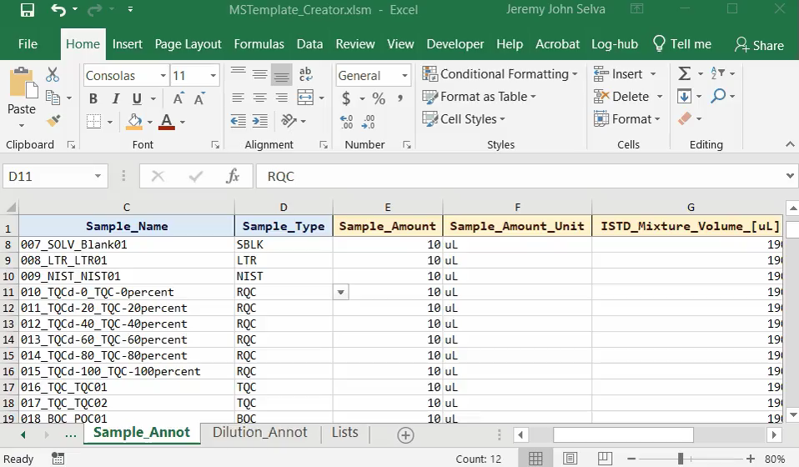
Load RQC Samples to Dilution Table

